Slide 1
Seasonal Traffic
Case Study

Slide 2
Backstory
TPC a marketing agency in New York state,
had the idea of publishing a seasonal marketing campaign to increase public transportation popularity.
For the campaign to success, they needed to observe the seasonal traffic in New York state public transportation.

Slide 3
Problem
For this project,
We used MTA Turnstile Data,
MTA is known as the biggest public transportation organization in the United States
We well focus on one station traffic, extracting the weekly median number of people in that station during winter & summer seasons

Slide 4

Goals & Vision
Goals
extracting the weekly median number of people in one station.
Comparing winter & summer traffics
Vision
Enable TPC to observe people traffic to manage the best campaign possible each season

Slide 5
الهيــــكــــــل التنظـــــيمي لفريق العمل
Project
Details

Slide 6

Sample size
Our studying data consists of 4 months as following:
January - February 2015 (Winter season)
July – August 2015 (Summer season)
This way we can state the number of people using public transport each season.

Slide 7

Scope
Our dataset shows station name, dates and entries.
using the data above:
We well observe only one station, taking dates of winter & summer seasons in consideration.
extracting single day entries
Calculating the median of 7 days entries
Inserting data into understandable plots

Slide 8
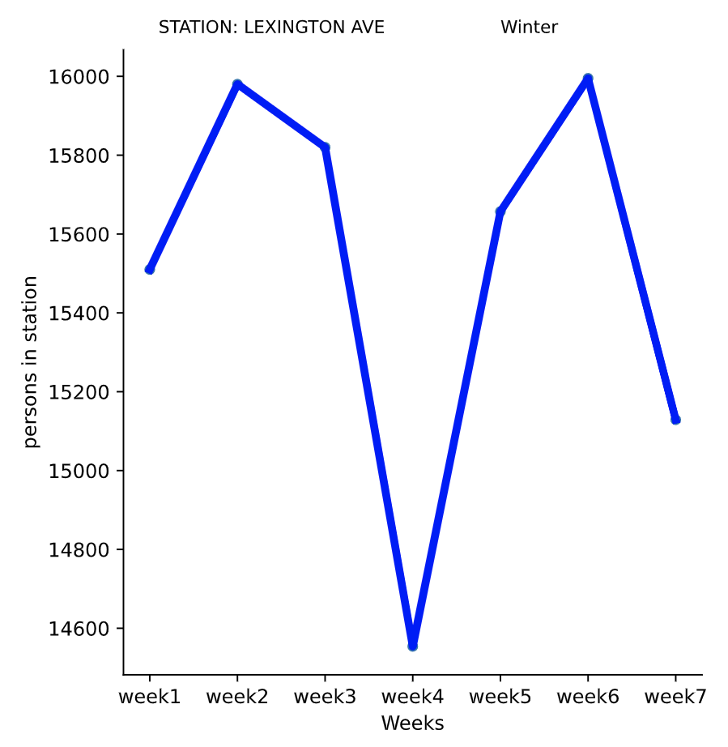
Winter Season
The chart aside show’s us the median number of persons in one station per week for the winter season from 01/03/2015 to 02/14/2015
The average number of persons using
LEXINGTON AVE station in winter season is around 108,500 person.

Slide 9
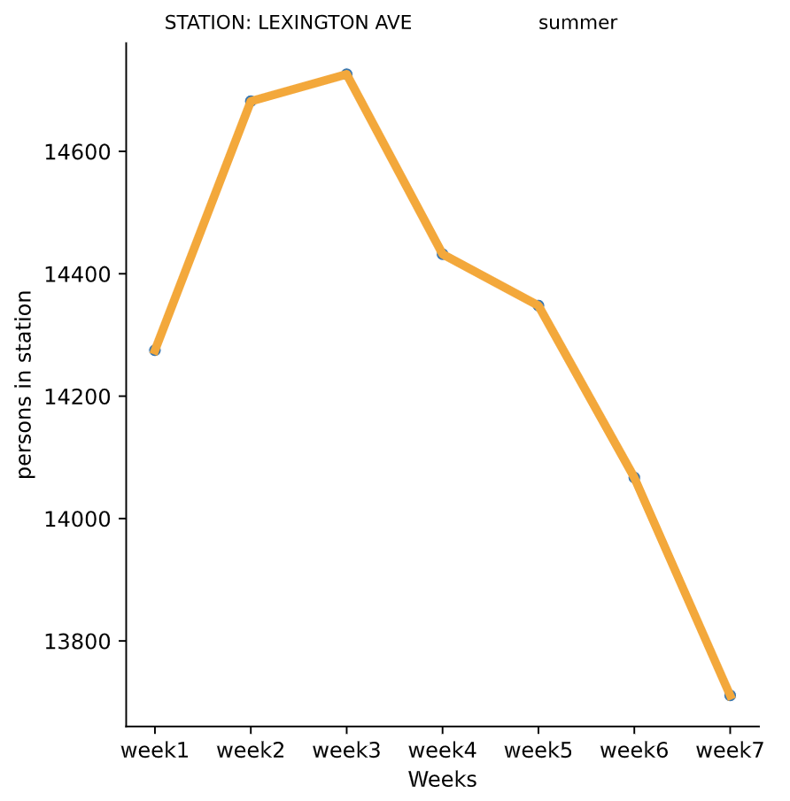
Summer Season
The chart aside show’s us the median number of persons in one station per week for the summer season from 01/03/2015 to 02/14/2015
The average number of persons using
LEXINGTON AVE station in summer season is around 98,800 person.

Slide 10

The End
Thank you for your time
I'll now answer any questions you have

